Slide 1

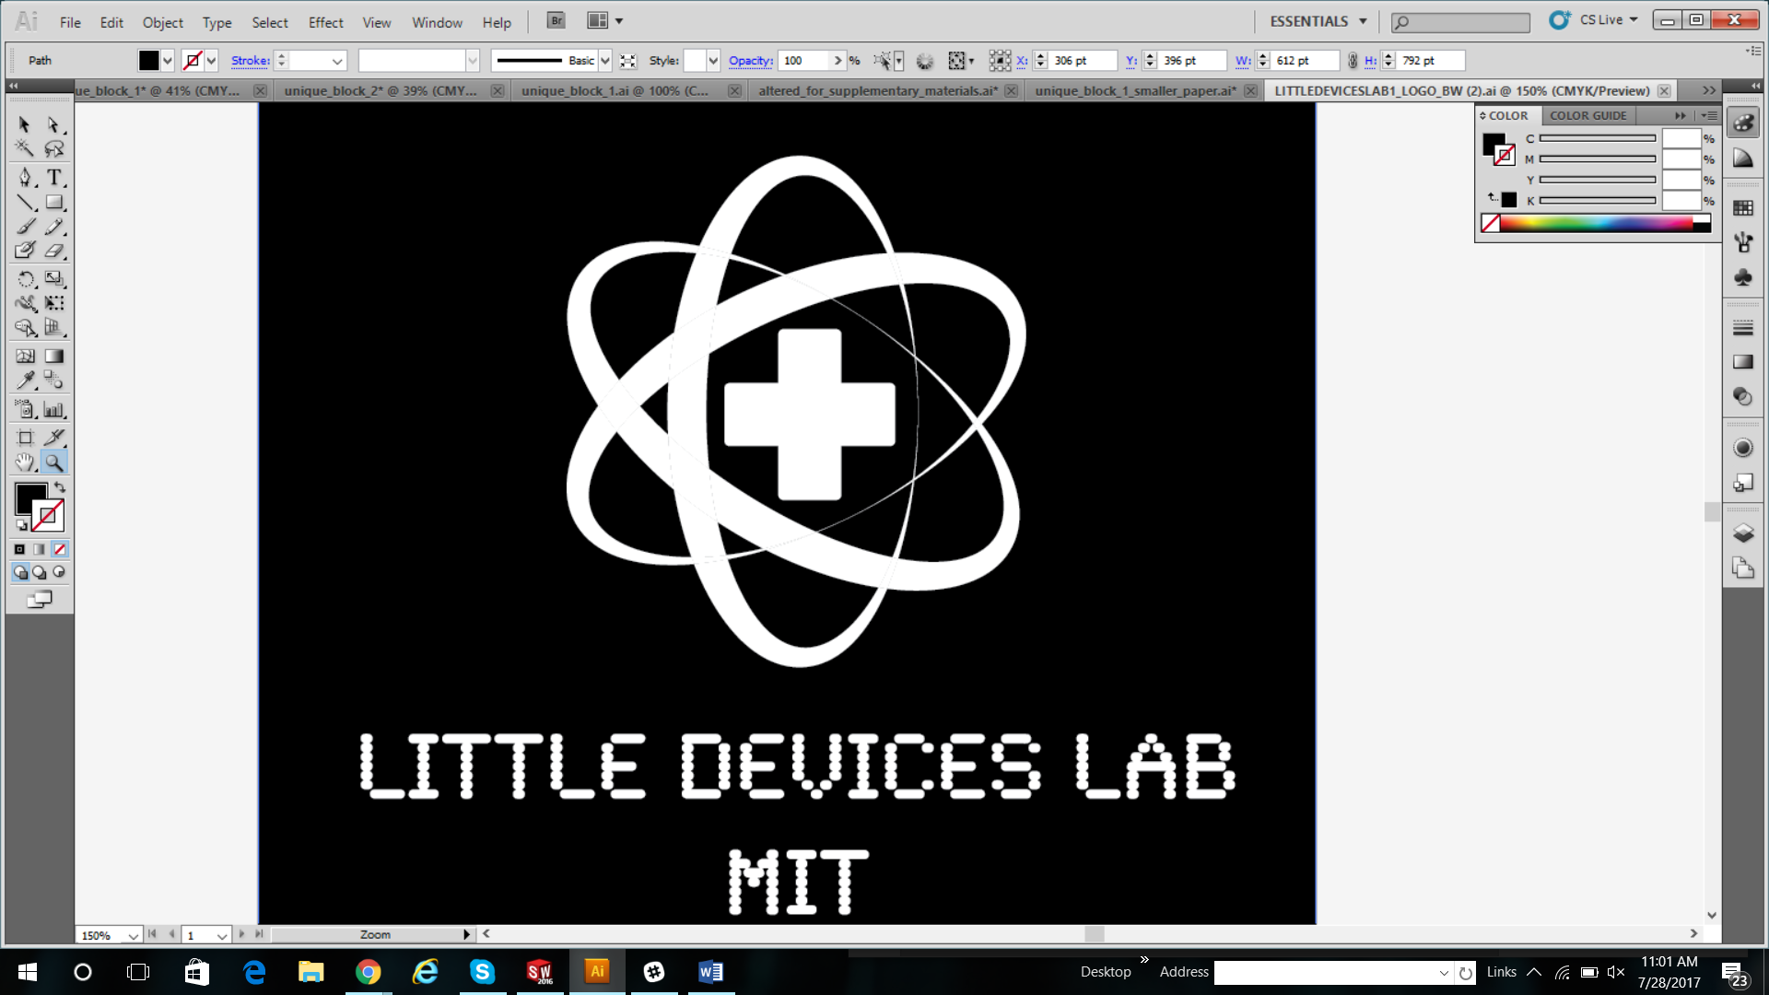
BIOREACTOR
July 29, 2017

Slide 2
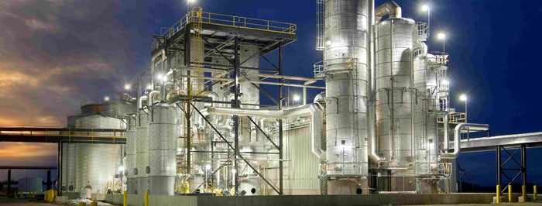
Introduction to Modern Bioreactors
Notes:
http://www.interstates.com/experience/experience-detail/18/Ethanol_Plant

Slide 3
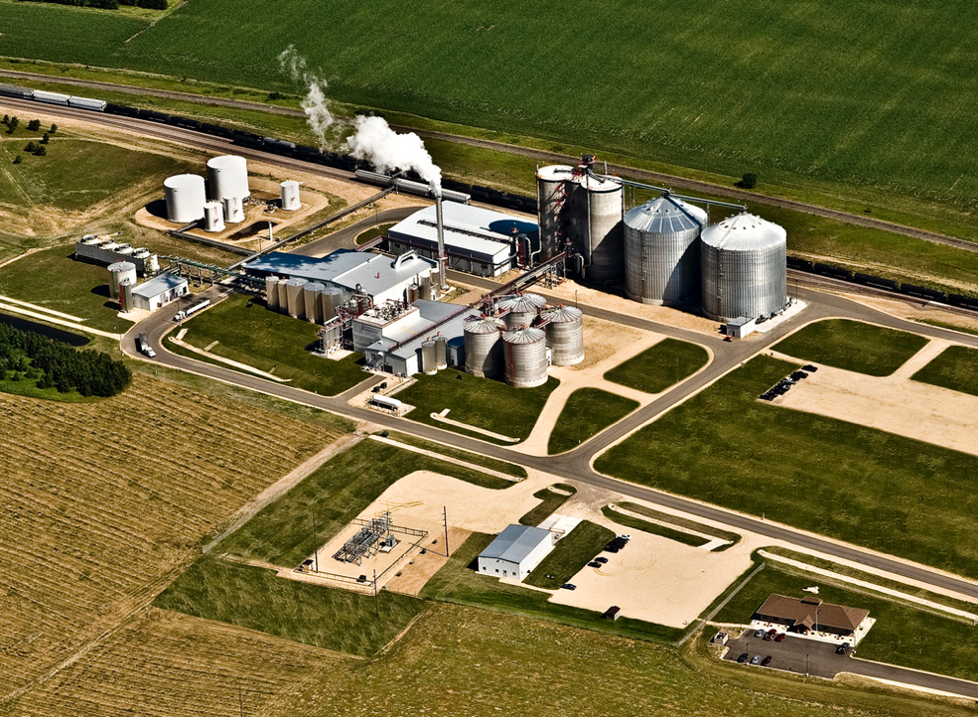
Ethanol plants are complex and it is not obvious what function each component serves
Notes:
http://ethanolproducer.com/articles/7963/western-wisconsin-energy-55-mmgy-ethanol-plant-up-for-grabs

Slide 4
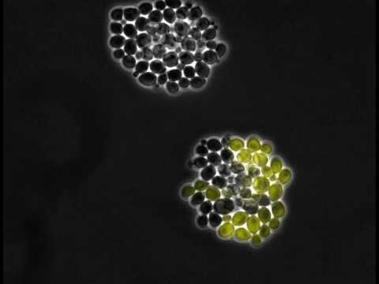
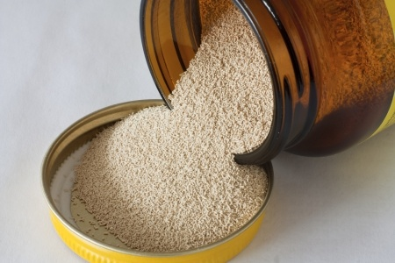
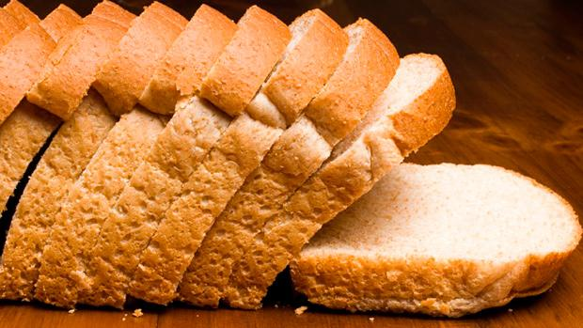
Yeast are single-celled microorganisms that you might commonly find in both labs and kitchens
Notes:
Bread pic: https://www.t-nation.com/diet-fat-loss/the-truth-about-bread

Slide 5
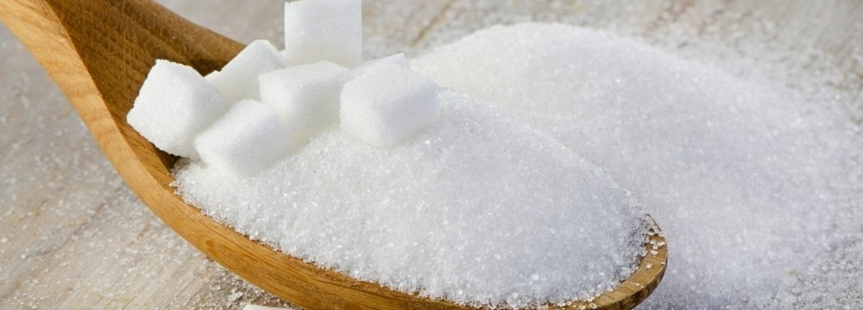
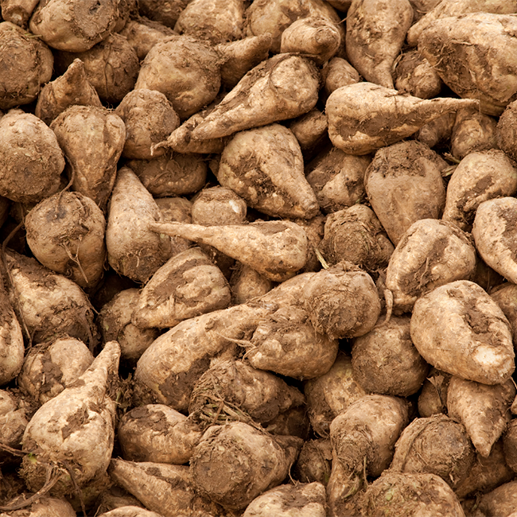
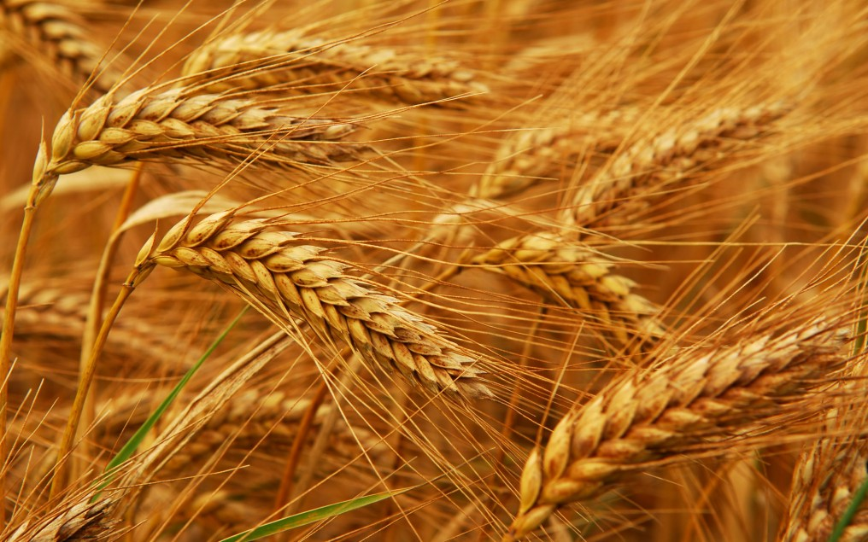
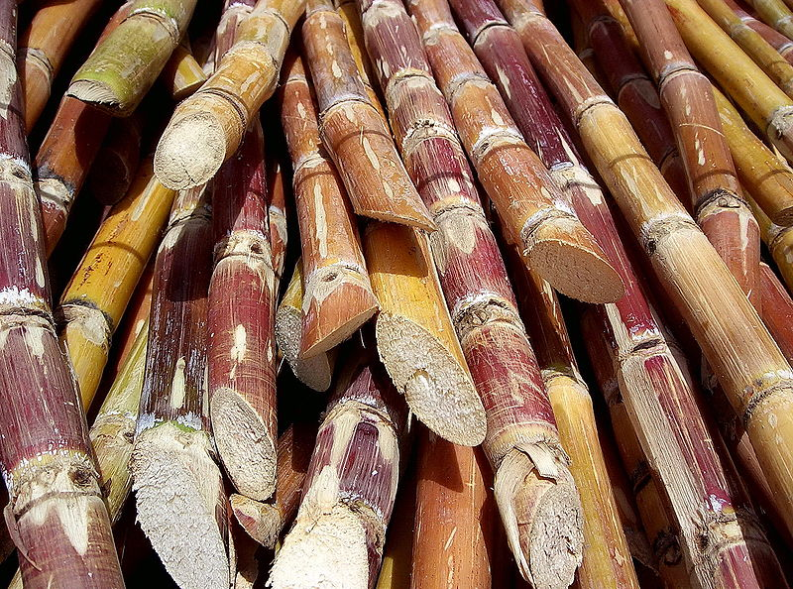
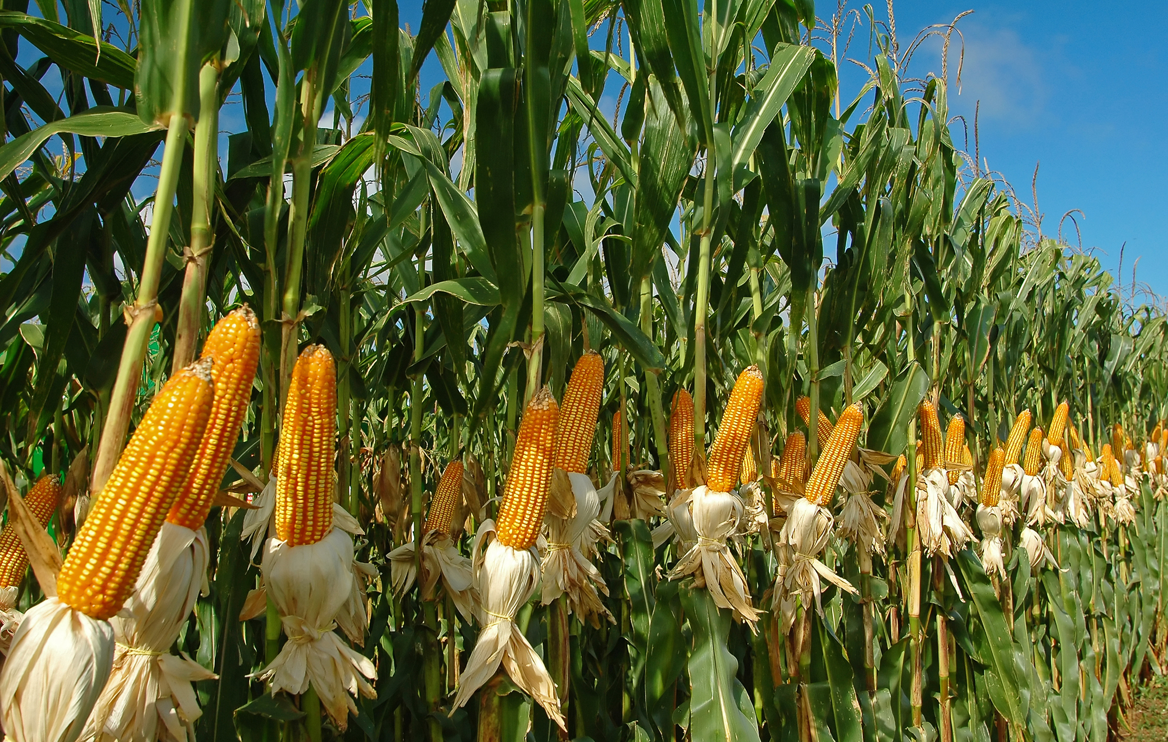
Yeast consume sugars (everything from wheat, barley, rice, and corn, to lab glucose)
Notes:
Images: http://www.weightzonefactor.com/blog/why-whole-wheat-bread-is-not-healthier-than-white/, https://financialtribune.com/articles/economy-domestic-economy/63081/gov-t-slashes-sugar-import-tariffs

Slide 6
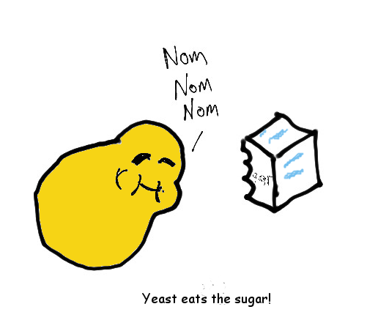
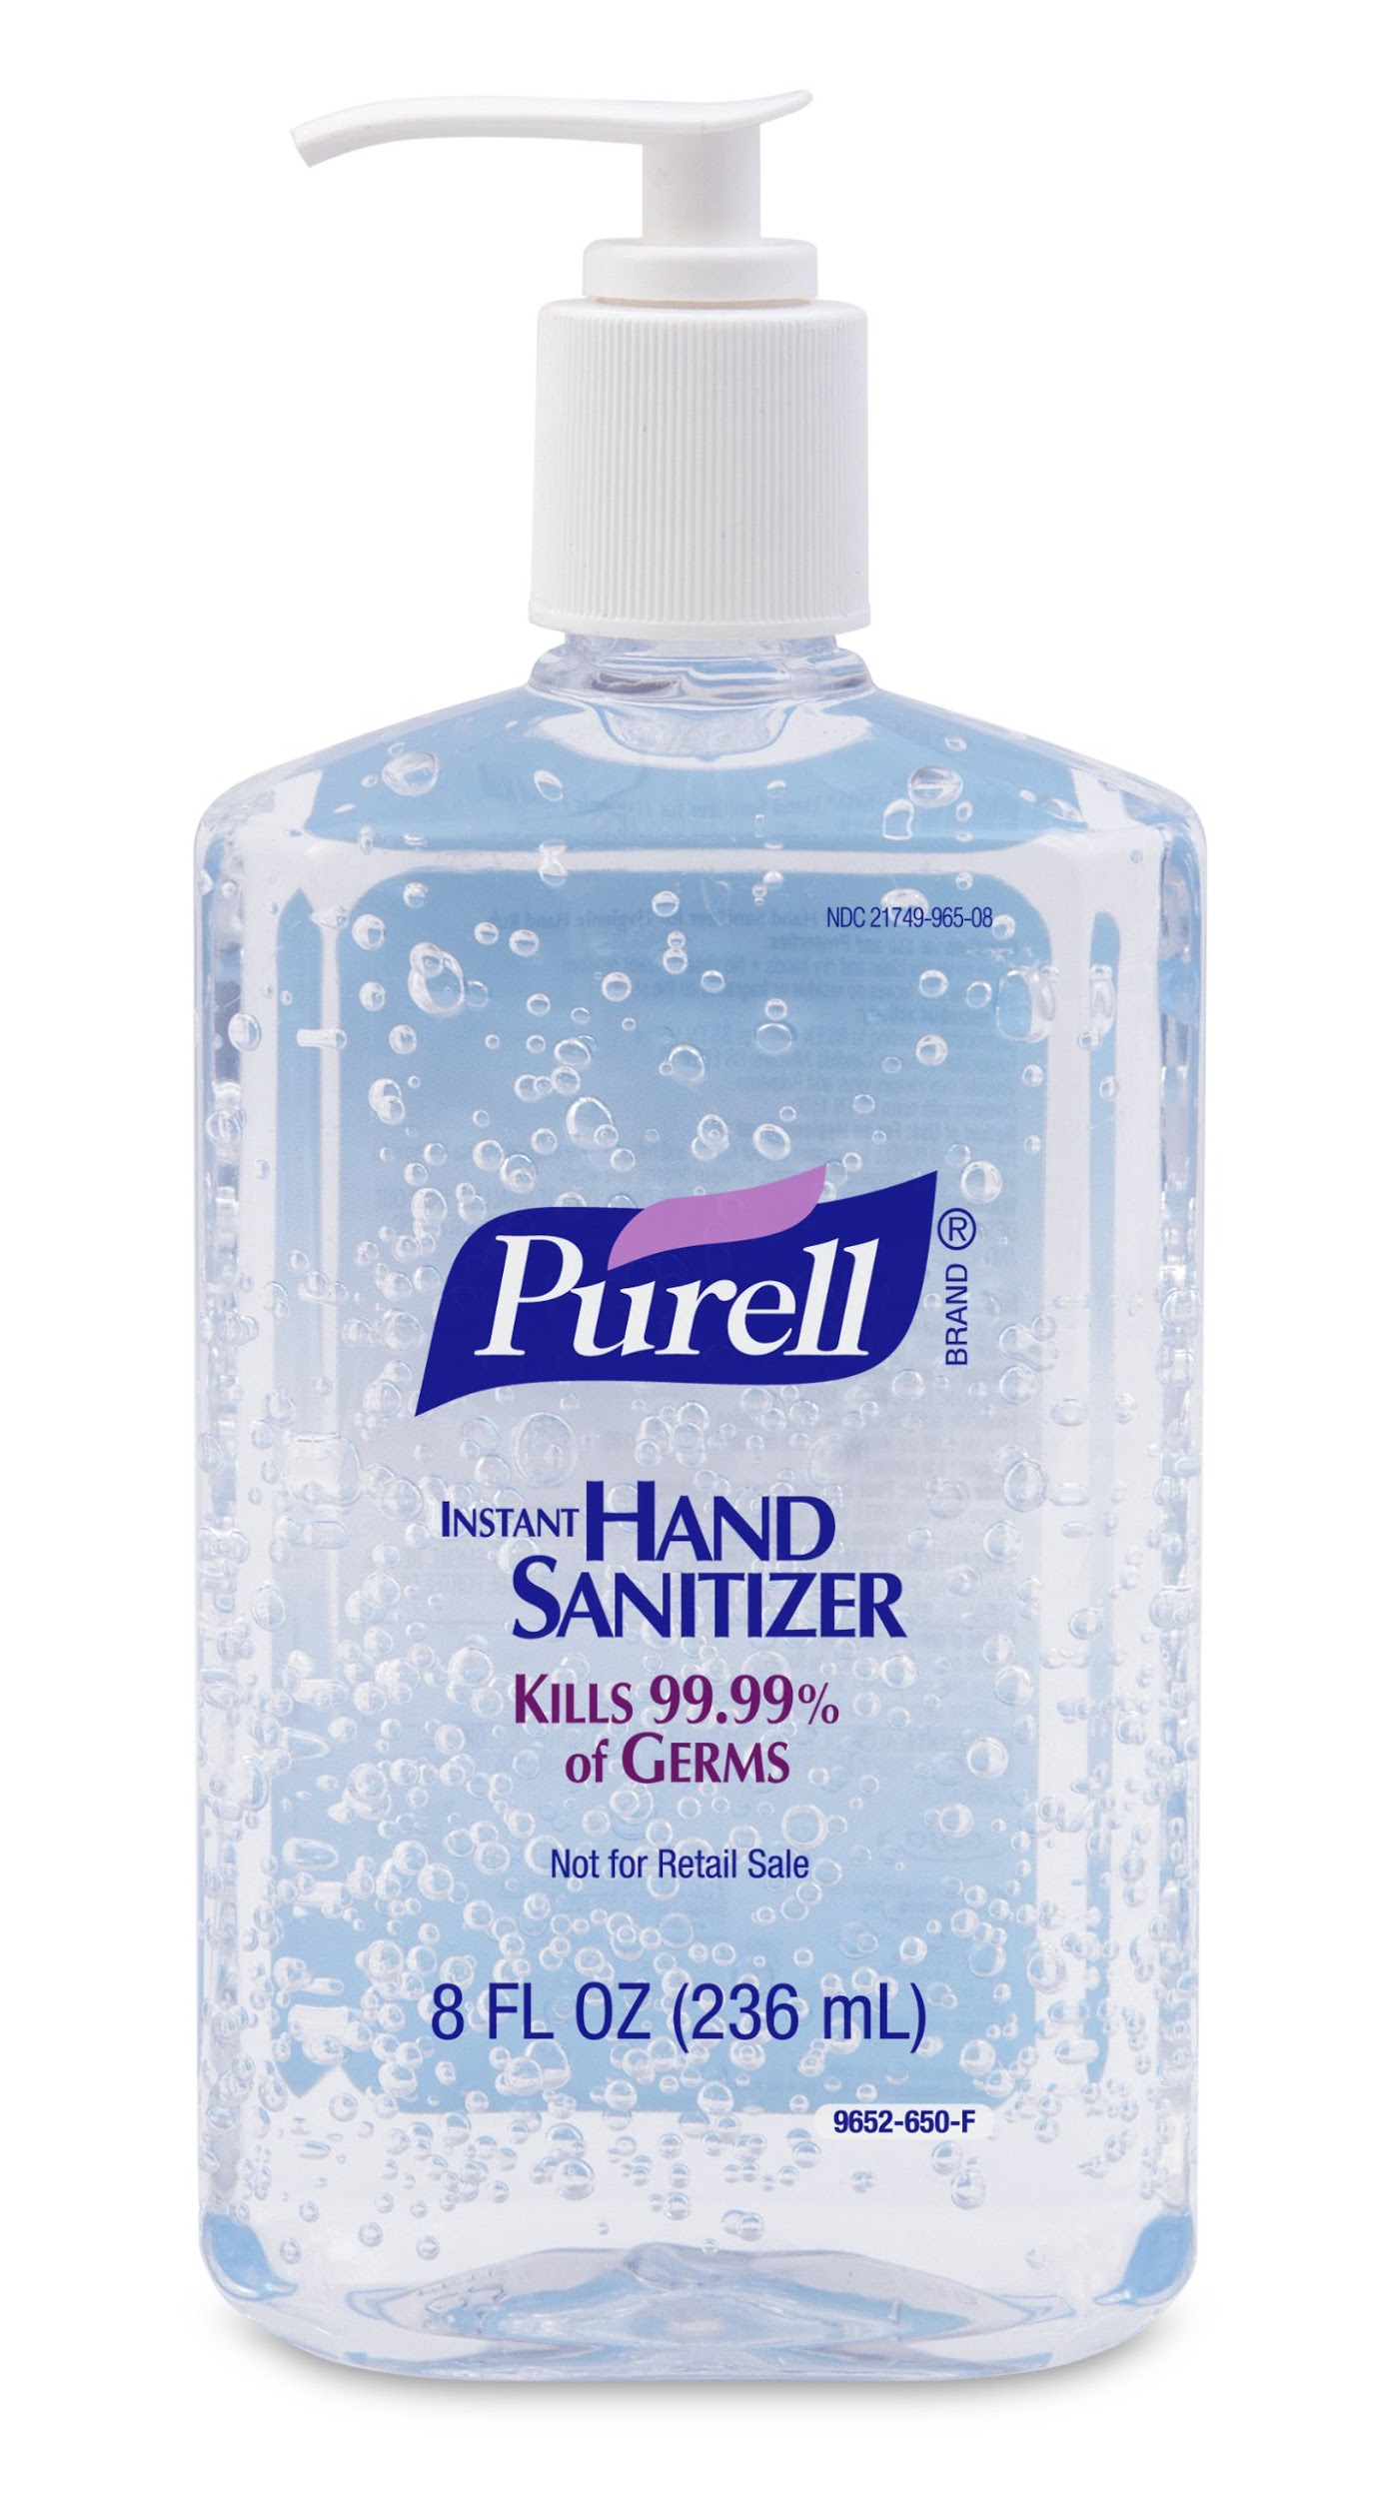
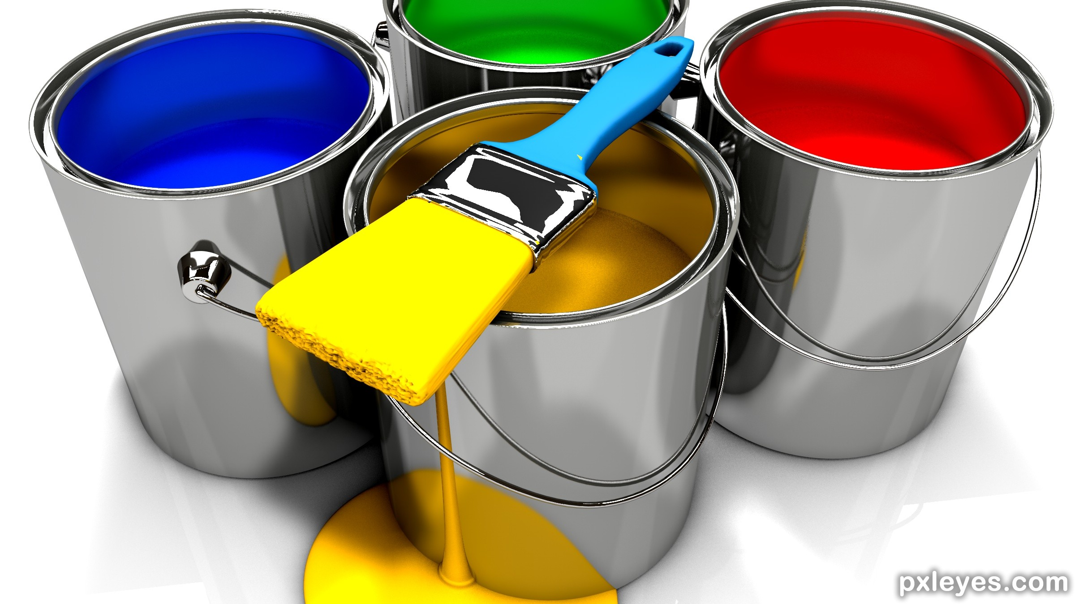
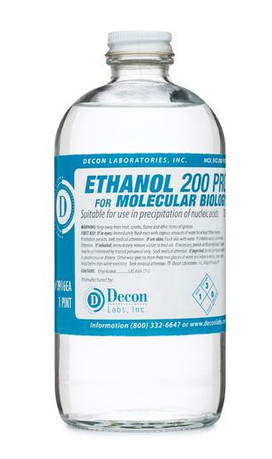
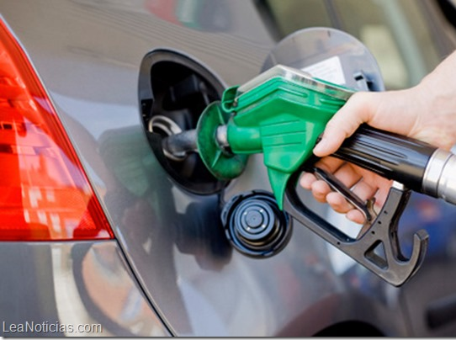
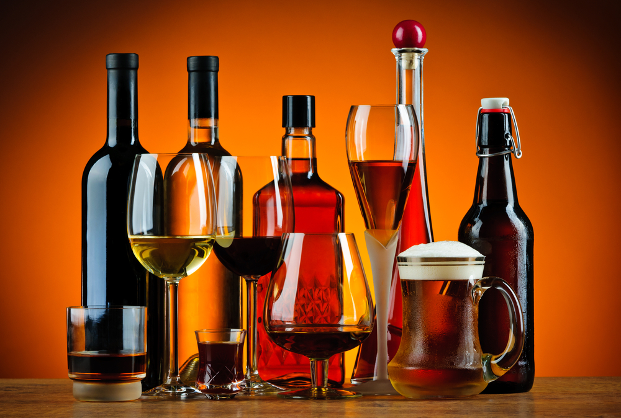
When yeast eat sugar, we call that fermentation and it can produce useful products: CO2 and Ethanol
Notes:
Image credits: http://bigmeankitty.com/fp/wp-content/uploads/2016/05/Alcohol.jpg, http://www.pxleyes.com/3D-contest/21149/brush-up-your-3D.html, http://deconlabs.com/products/molecular-biology-ethanol/,

Slide 7
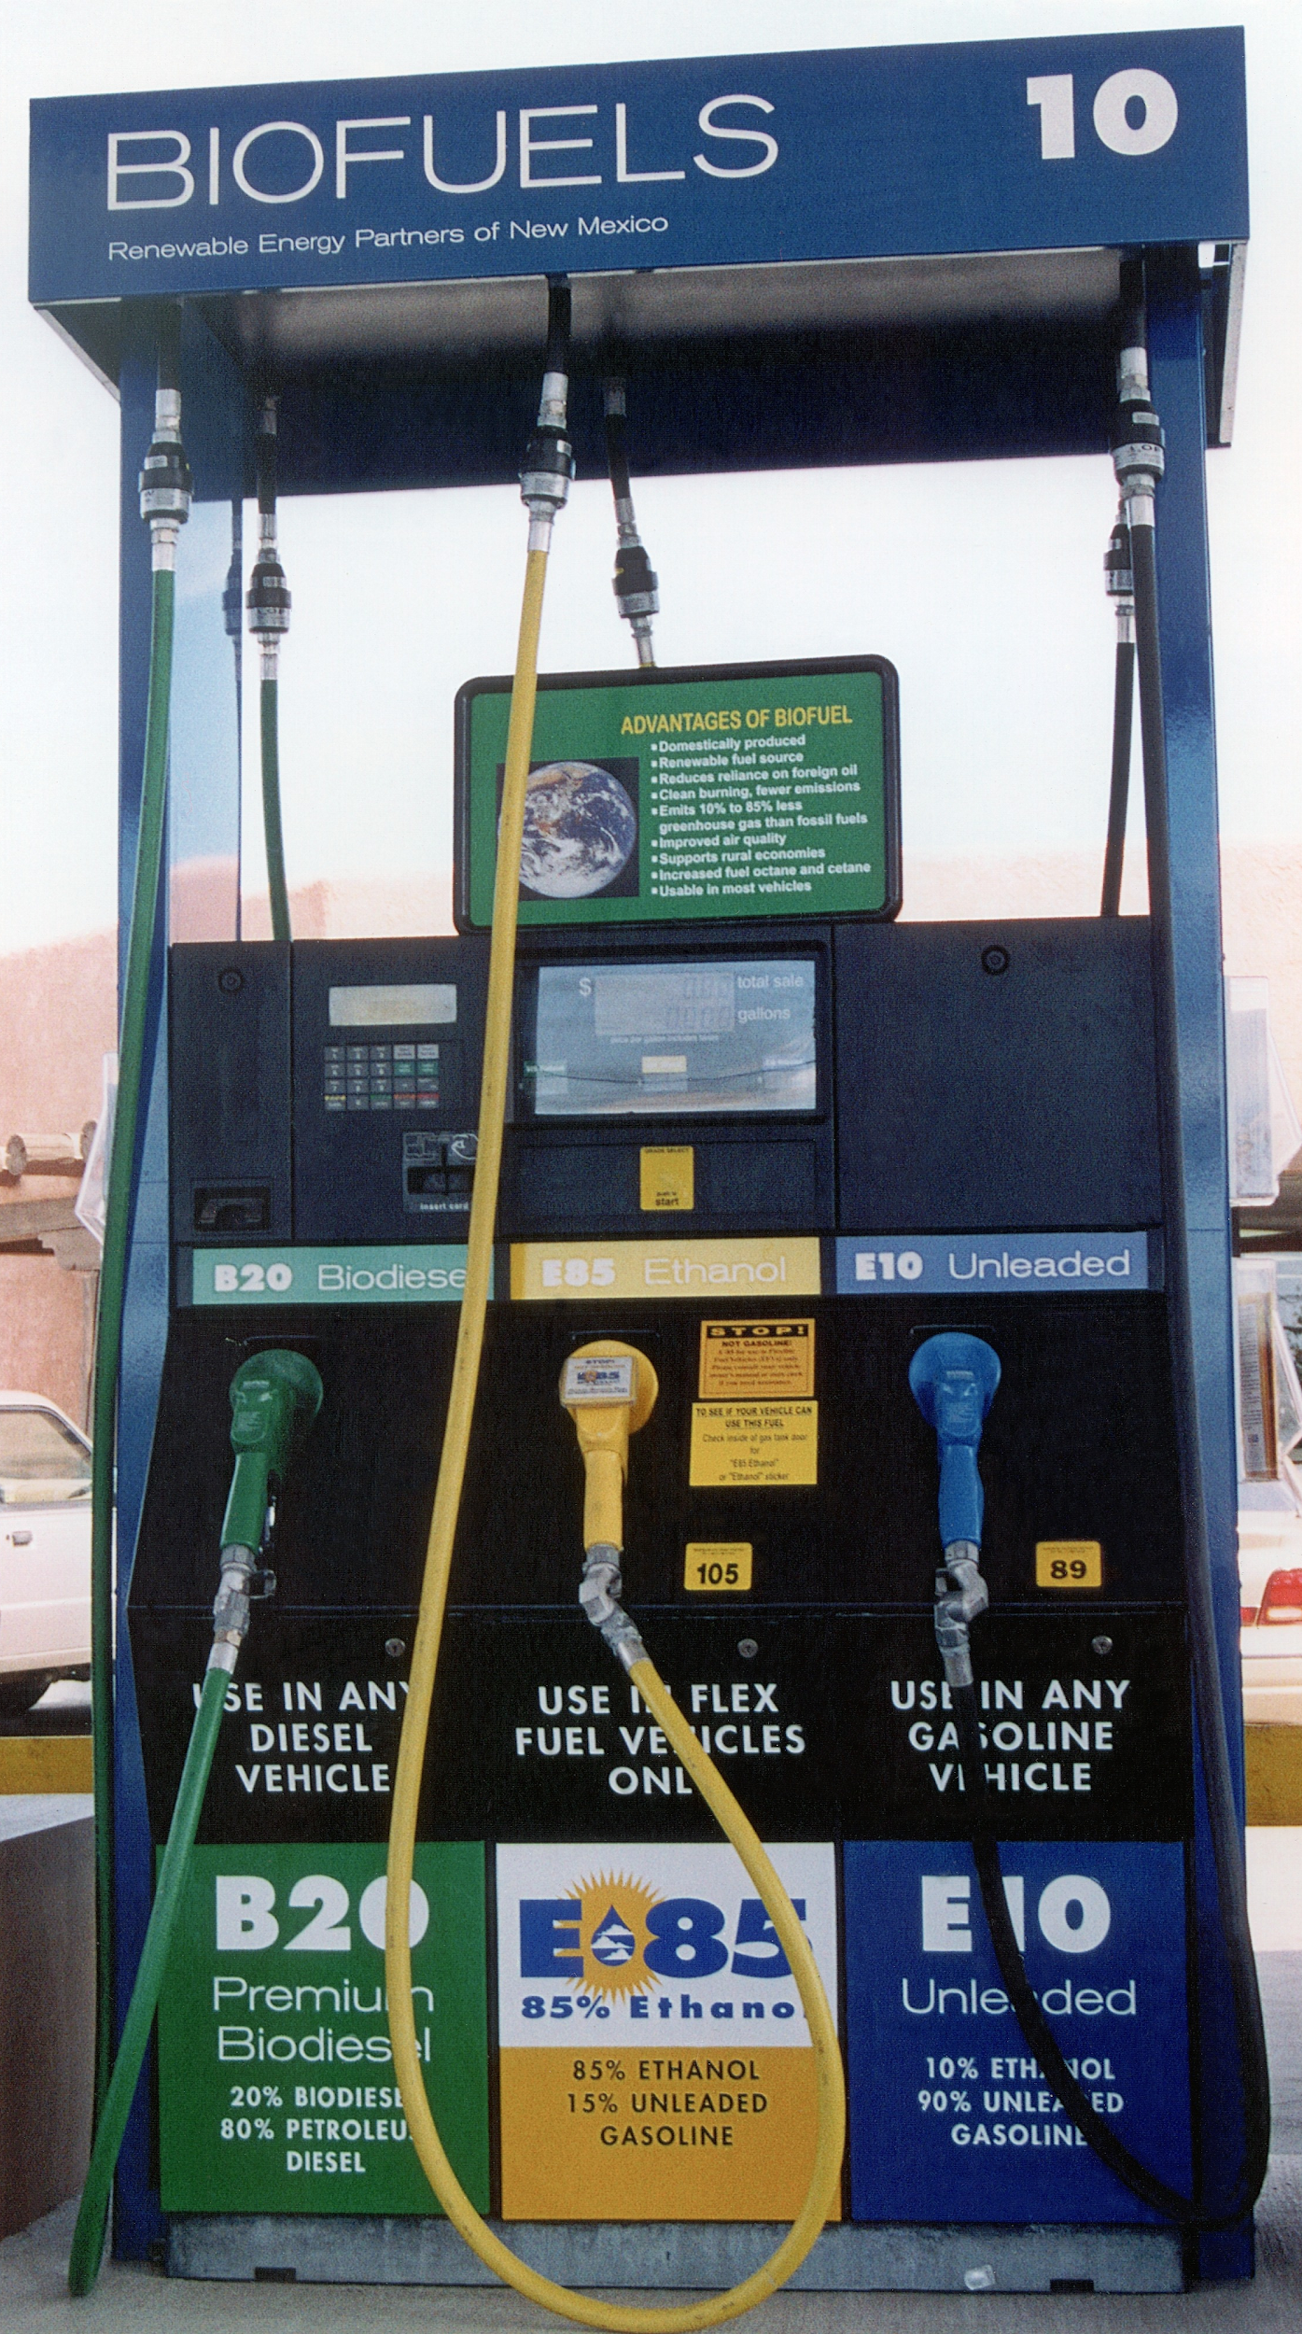
Ethanol as a Biofuel
Ethanol is made from biomass (plant materials) and today is present in upwards of 97% of U.S. gasoline where it helps to reduce air pollution and serves to oxygenate the gasoline
Most of the ethanol produced in the US is made from corn grain and it has a positive energy balance
A positive energy balance is when the sum total of the energy that went into the corn and the fuel production is less than the total energy contained in the fuel

Slide 8
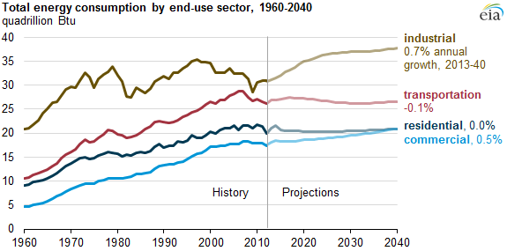
Energy Demand
Source: U.S. Energy Information Administration
Notes:
https://www.eia.gov/todayinenergy/detail.php?id=21012

Slide 9
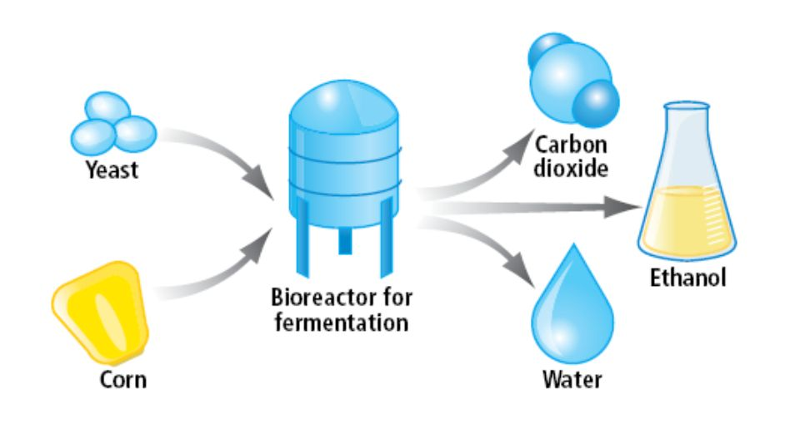
In a typical plant, we need to connect the fermentation tanks, with other tanks that collect useful products
Notes:
http://slideplayer.biz.tr/slide/10943534/

Slide 10
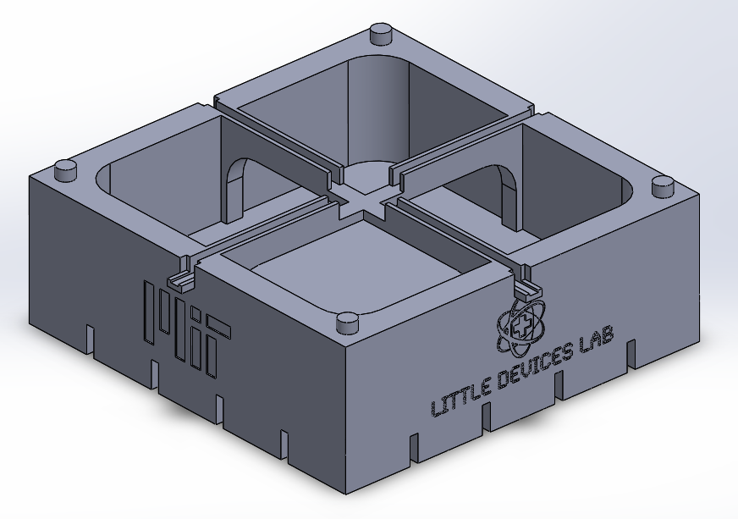
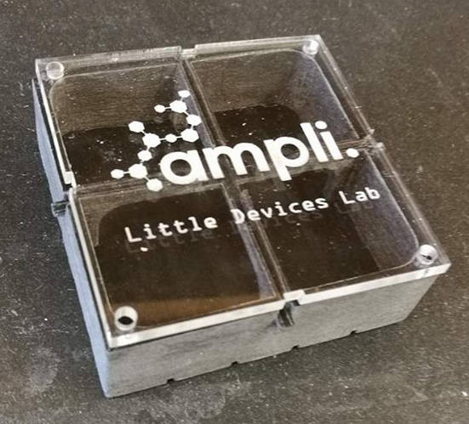
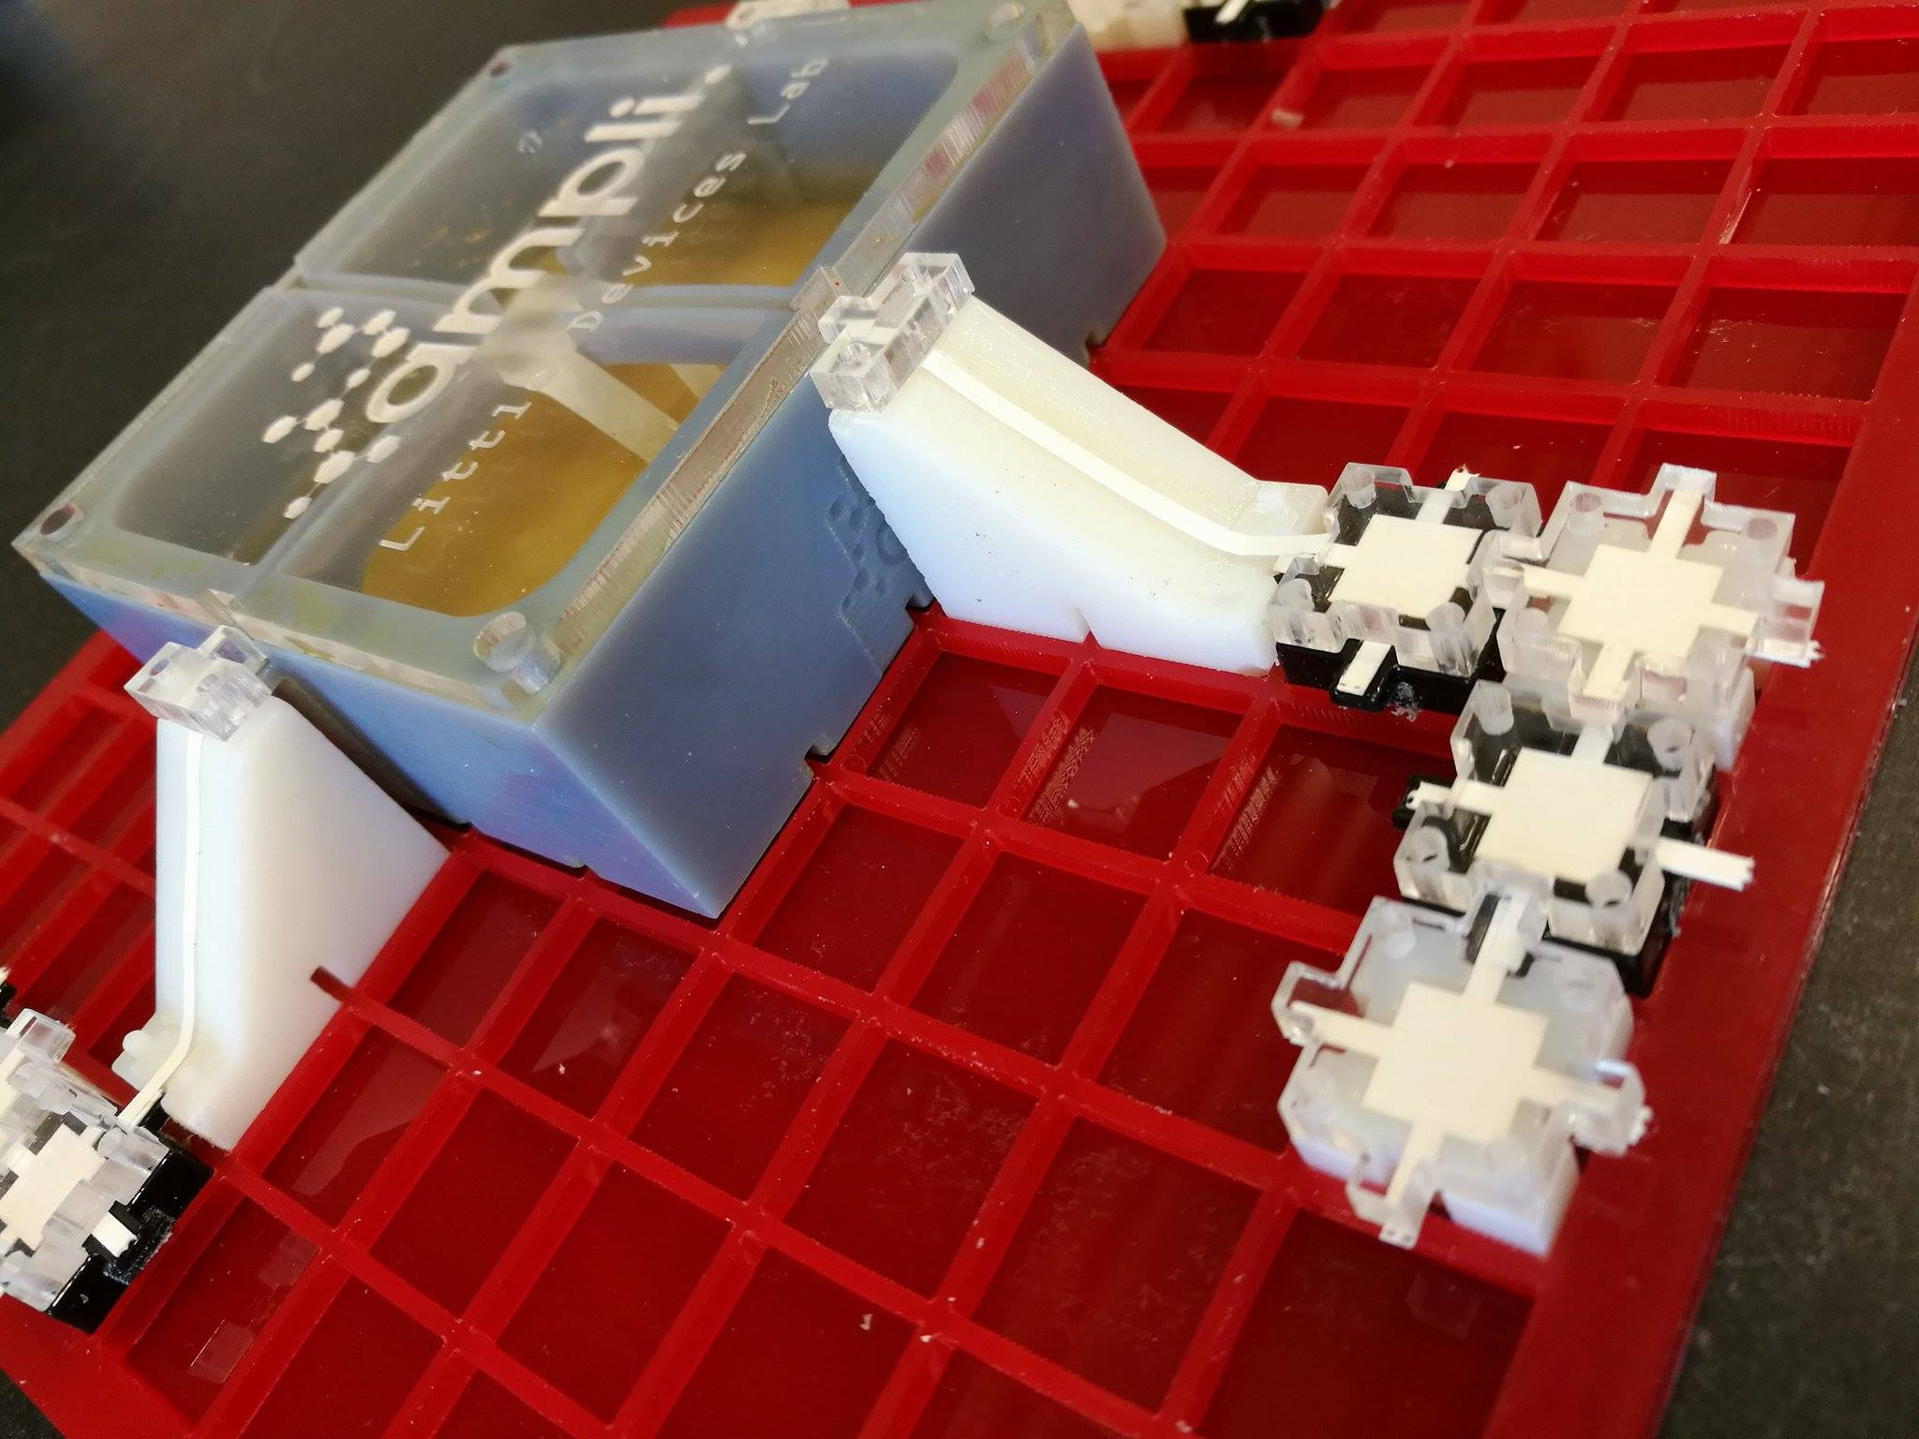
The Ampli Bioreactor
Notes:
Kept weird photo for presentation

Slide 11
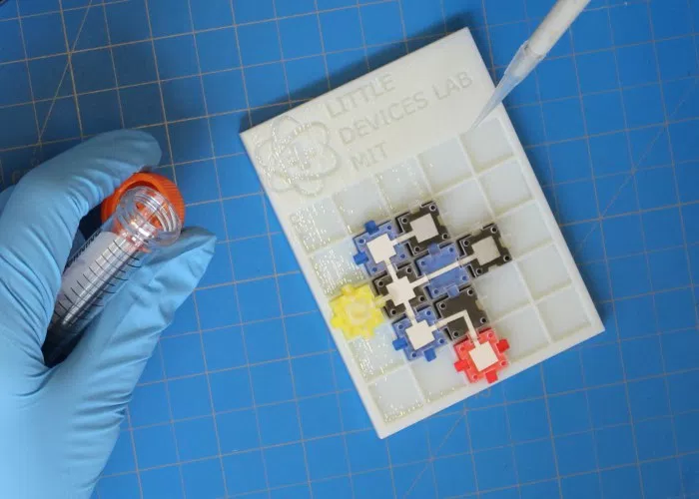
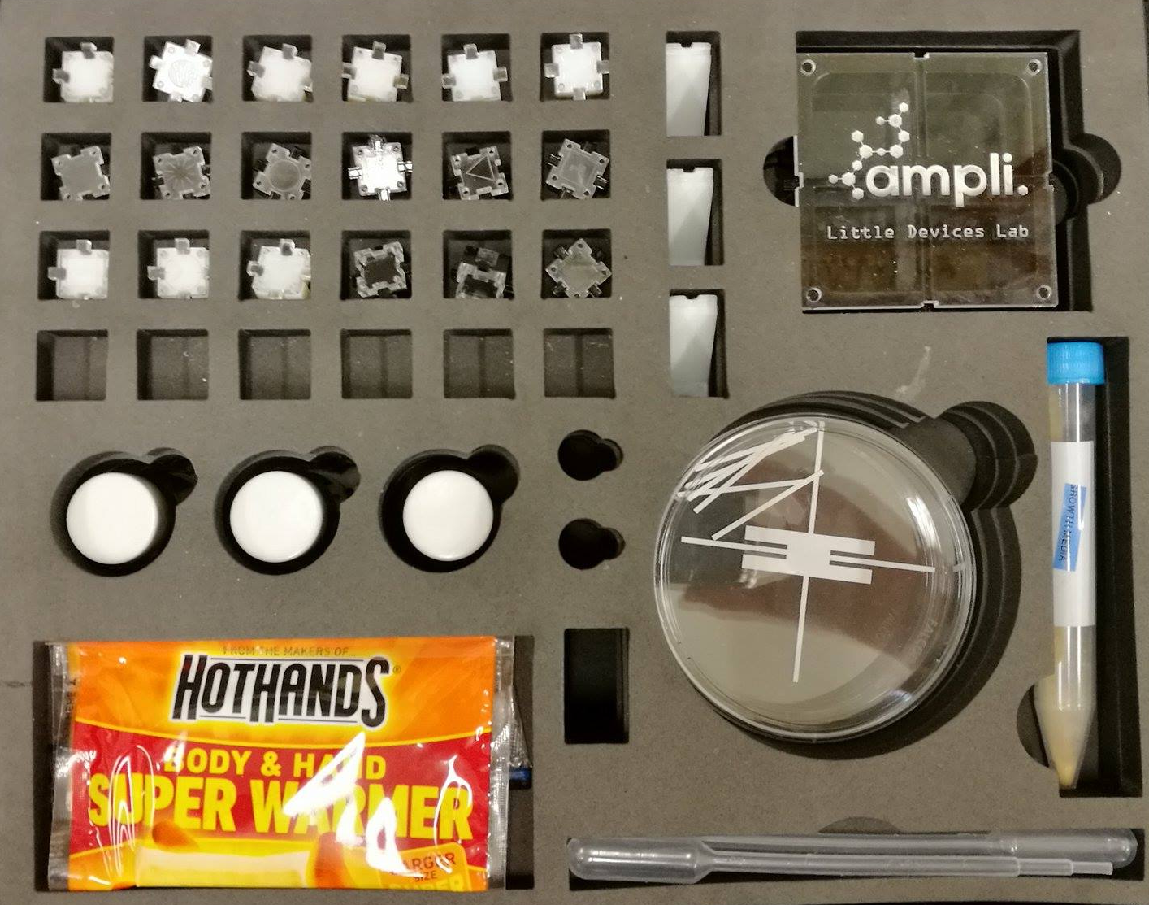
Ampli chemical circuit
Ampli biochemistry kit

Slide 12
Ampli Bioreactor
Introductory Level
BIOREACTOR

Slide 13
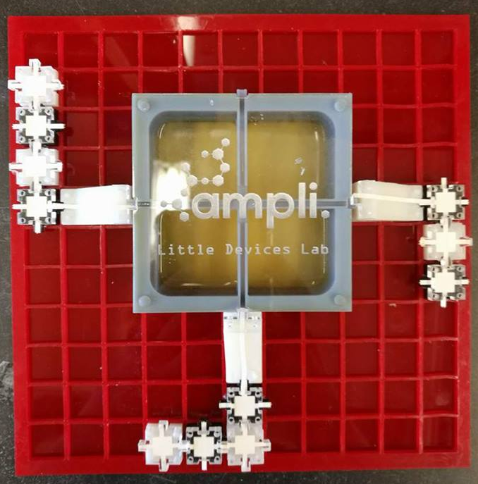
Introductory Level Ampli activities:
Free-form experiment design:
Test flow with food coloring
Raise and lower pH
Create chemical circuits!
Study fermentation:
Examine & quantify ethanol production
Observe by-products of fermentation such as pressure & temperature changes
Compare fermentation to regular yeast growth

Slide 14
Ampli Bioreactor
Advanced Level
BIOREACTOR

Slide 15
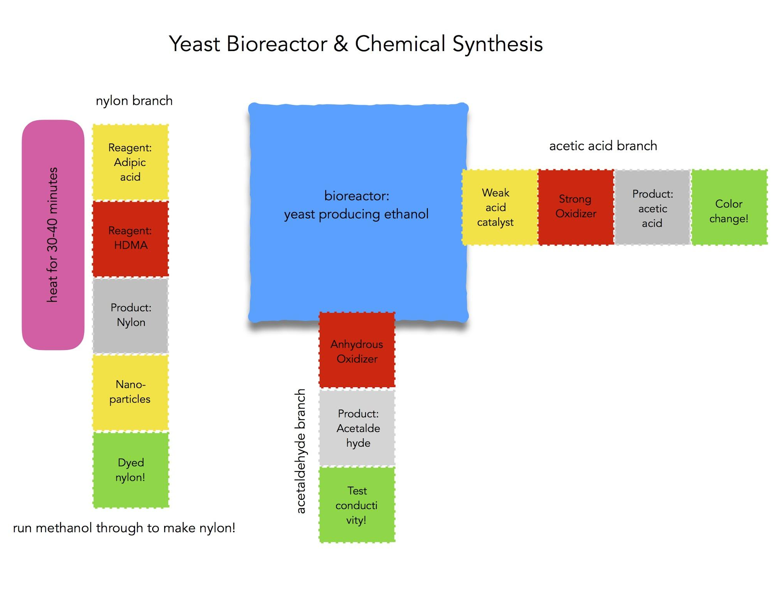
Advanced Level Ampli activities:
Chemical Reaction Circuit:
Set up a linear chemical reaction
Employ heating and pipetting elements
Discover uses of nanoparticles
Create nylon polymers!
Organic Synthesis using Bioreactor Products:
Evaluate fermentation success
Use bioreactor ethanol in multiple simultaneous chemical reactions
Carry out organic synthesis of ethanol derivatives
Evaluate products with pH, conductivity, and more!

Slide 16
LEARNING GOALS
Learn about manufactured systems for harnessing biology and chemistry
Study the life and feeding cycles of yeast
Learn about the importance of ethanol and biologics in energy production
De-mystify the operation of industrial chemical plants
Design chemical reaction circuits similar to flow chemistry systems
Discover a powerful toolbox of organic synthesis reagents
Construct and carry out biochemical experiments in an accessible, customizable format

